Slide 1


HVS​
Concept of VehMot Management

Slide 2

Contents
Vehicle Speed
Acceleration calculation
Slope Estimated
Resistance estimation

Slide 3
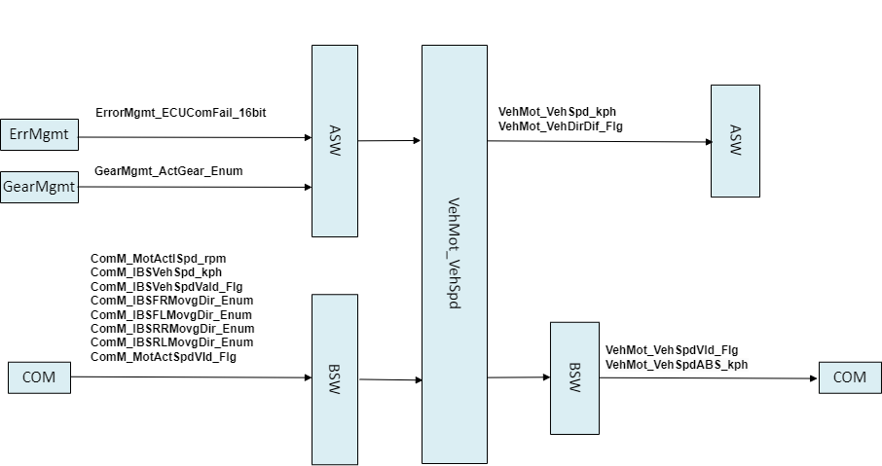
Vehicle Speed
By accepting the speed judgment of IBS and MCU, the module outputs the final speed and effectiveness. In the case that IBS is invalid or IBS is lost, the wheel speed of MCU is used to calculate the speed. The speed sent to Com does not distinguish the direction; The direction of vehicle movement is judged according to the wheel direction of IBS.

Slide 4
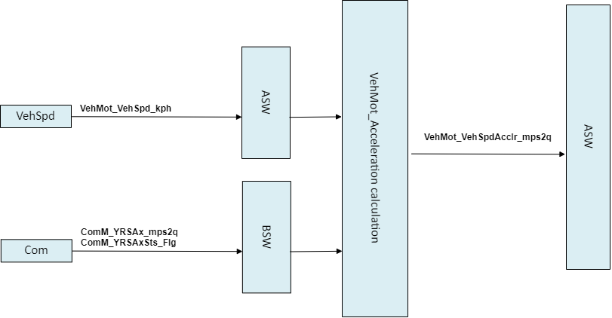
Acceleration calculation
errors
Acceleration is calculated according to the speed sent by the speed module. At present, the speed is delayed by 5 ticks, and the speed difference ratio is 1s.

Slide 5
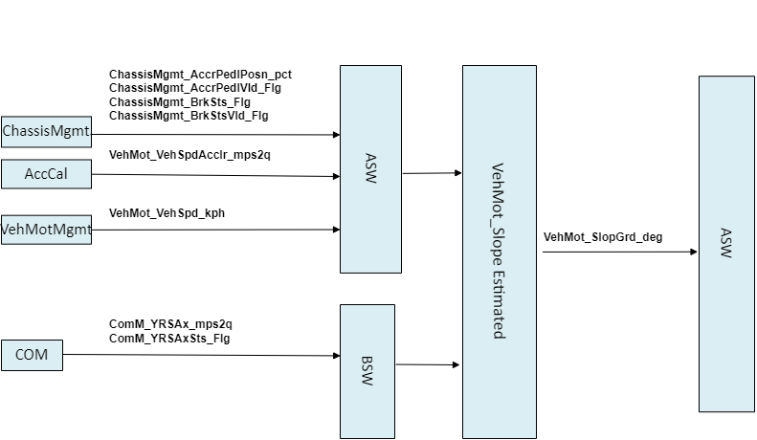
Slope Estimated
errors
The module calculates the slope of the vehicle; According to the longitudinal acceleration signal of the vehicle sent by IBS, the ramp calculation under different working conditions is carried out in combination with the acceleration pedal and the brake pedal, and the working conditions should be distinguished between normal driving and stationary state of the vehicle.

Slide 6
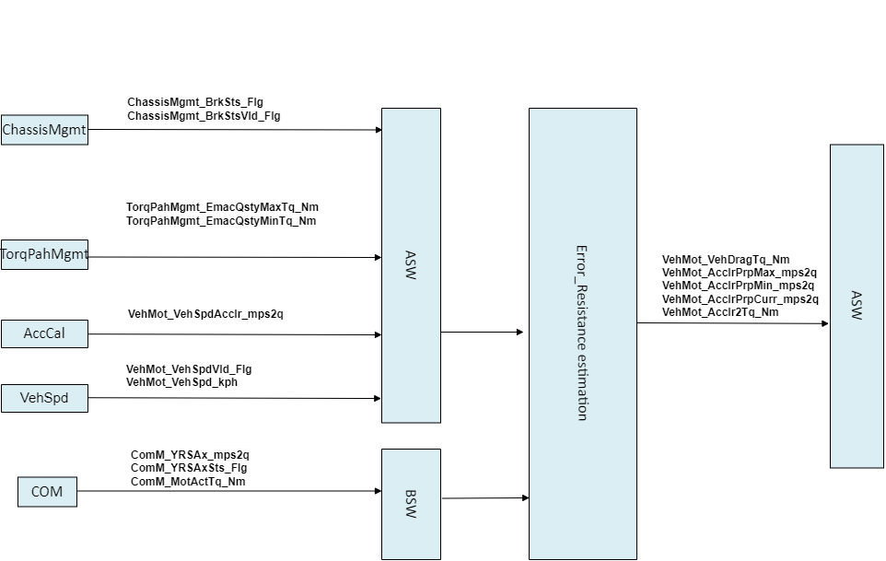
Resistance estimation
errors
The module is responsible for calculating the resistance of the vehicle. The difference between the output torque of the MCU and the actual torque of the wheel is calculated to obtain the driving resistance of the vehicle.

Slide 7
Backup

